Slide 1
Apache SPARK MLLIB ALS Optimization
Peng Meng
peng.meng@intel.com
BDT/STO/SSG
Notes:
Good afternoon,
My name is Peng Meng, I come from Intel.
The work of this topic was done when I was in Big Data team, one of my job in Big Data team is to optimize spark mllib performance.
Now, I am in a deep learning team, my fouse is to optimize DL framework performance on CPU which includes caffe, mxnet, tensorflow.

Slide 2
Agenda
ALS Introduction
Problem Statement
Solution and Performance Benchmarks
References
Notes:
This is the agenda of this topic.
First, I give a brief introduction about ALS, alternating least squares, which is a popular recommendation algorithm in spark mllib.
I will not introduce the detail about the training of ALS, this topic will focus on how to optimize the prediction process of ALS.
If you not familiar with spark mllib ALS, it is not a problem to understand this topic.
Because the prediction of ALS is very simple, the process is two matrices multiplication, then get the topK values of each row and the values index.
After a basic introduction about ALS, I will introduce the problem of previous ALS prediction.
Then show our solutions and performance benchmarks.
I sumitted several PRs to spark community for ALS optimization, the reference will list the related PRs of this Topic.

Slide 3

ALS Introduction
Recommendation algorithm is the key to success for many Internet companies
ALS (Alternating Least Squares) is a very popular recommendation algorithm in Spark MLLIB
Notes:
Recommendation algorithm is the key to success for many internet companies. When you visit youtube or amazon, many of the items in the page are generated by one or more recommendation algorithms. A large part of click is through recommended items.
ALS is a very popular recommendation algorithm in Spark MLLIB. I will give a basic introduction about how ALS works.

Slide 4
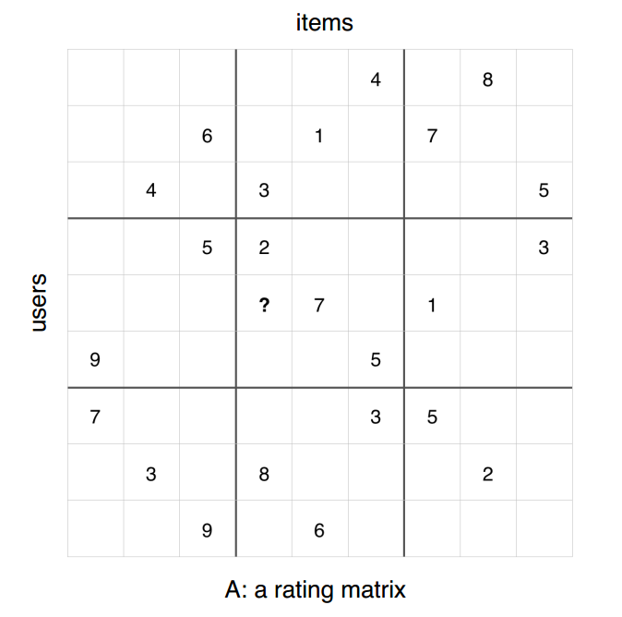
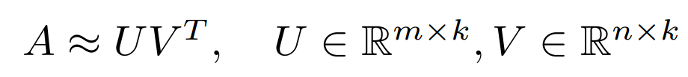
ALS Introduction
ALS training process
Given a rating matrix A, find U and V. In this process, it only checks observed values in matrix A.
* Picture from https://stanford.edu/~rezab/sparkworkshop/slides/xiangrui.pdf
Notes:
To use ALS to do recommendation, first, you should have a rating matrix.
This picture shows a rating matrix, which includes nine users and nine items. For each row, means a user, and each column mean an item or product. For row one, there is value in column 6 and column 8, means user 1 like item 6 and 8.
This values can be collected by the users buy or click history.
For recommendation algorithm, the key is to know the value of empty positon in the matrix.
ALS is an algorithm to input the empty positons of the rating matrix.
First, ALS factorize the rating matrix A to two skinny matrix, U and V, for example, The size A is one million by one million, and U is one million by 20, an V is also one million by 20.
And U multiply transpose V will approximately equal to A for all the positons there is a value in A.
When do recommendation, we use U multiply transpose V to replace A. There is value in each positon of the generated rating matrix.
So we can find the topK value of each row, the indices of each value means the item recommended to the users.

Slide 5
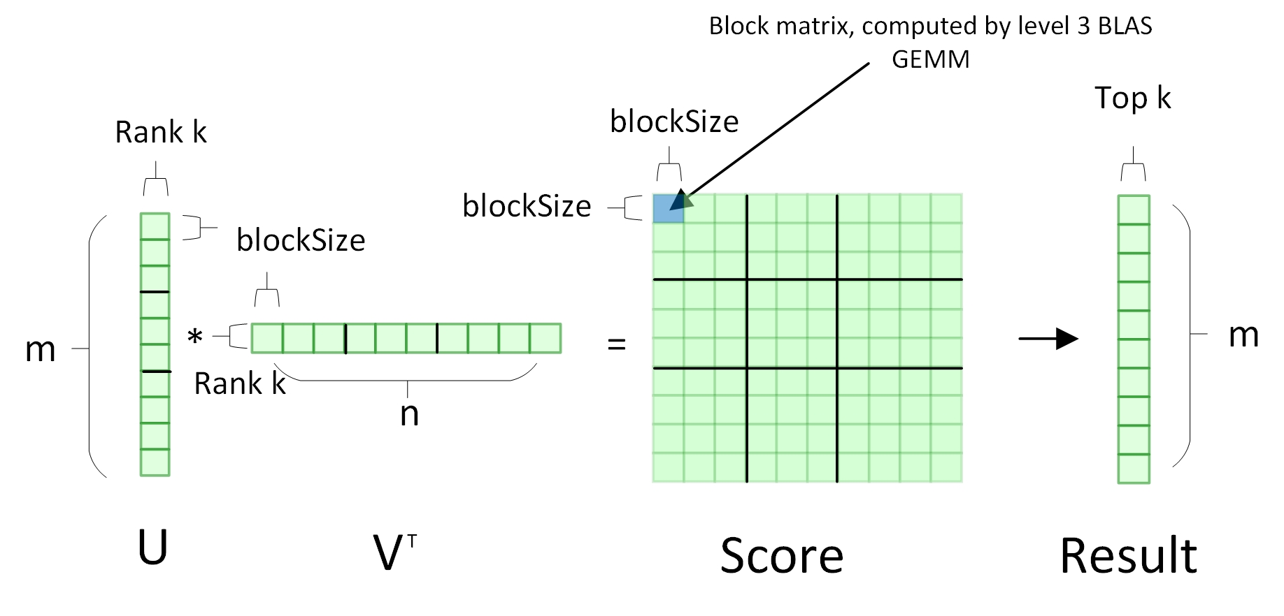
ALS Introduction
ALS prediction process
Given U and V, recommend topK items for each user.
Typical value:
Users m = (millions)
Items n = (millions)
Rank k = 20
BlockSize = 4096
TopK = 10
Notes:
This picture shows the ALS prediction process.
In spark mllib, U and V is saved in an RDD, so the value of U and V is distributed in the cluster. As this picture shows, U and V is split to three partitions and In each partition, the U and V is blockified to small matrix. Each small box of U and V means a block matrix, the typical size is 4096 by 20.
There are two reasons to blockify U and V to small matrix: first in real product, the size of each partition is still very large, so it is necessary to blockify it to call native blas GEMM.
The second reason is to reduce the number of duplicated fetch remote partition, we will introduce this later.
Distributed Matrix multiplication in spark mllib is implemented using a Cartesian product.
After we get the score matrix by GEMM, each value of the score matrix is changed to a key value pair ( the key value pair is an object, the key is the user id, the value is item it and item value).
Finally, the record with the same user id is shuffled to the same machine, that machine get the topK value of each user.

Slide 6
ALS Introduction
val ratings = srcBlocks.cartesian(dstBlocks).flatMap {
case ((srcIds, srcFactors), (dstIds, dstFactors)) =>
rating =srcFactors.transpose.multiply(dstFactors)
m = srcIds.length
n = dstIds.length
output = new Array[(Int, (Int, Double))](m * n)
rating.foreachActive { output += (srcId, (dstId, r))}
output.toSeq
}
ratings.topByKey(num)
Notes:
This is the code of the previous ALS optimization.
It is direct and simple.
srcBlocks is

Slide 7
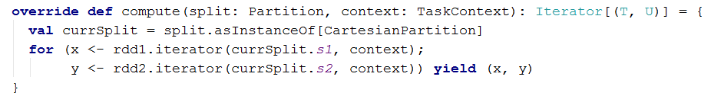
Problem Statement
ALS prediction process in Spark MLLib has very bad performance due to 2 major causes:
Serious GC caused by many small objects
CartesianRDD implementation will request multiple times of data across the cluster
val ratings = srcFactors.transpose.multiply(dstFactors) // call the Level 3 BLAS API.
val output = new Array[(Int, (Int, Double))](m*n) // m = n = 4096, too many small memory pieces, will cause serious GC issue
var k = 0
ratings.foreachActive { (i, j, r) =>
output(k) = (srcIds(i), (dstIds(j), r))
k += 1
}
The Data block of currSplit.s2 in rdd2 will be fetched remotely
many times (record count of currSplit.s1) in each task

Slide 8
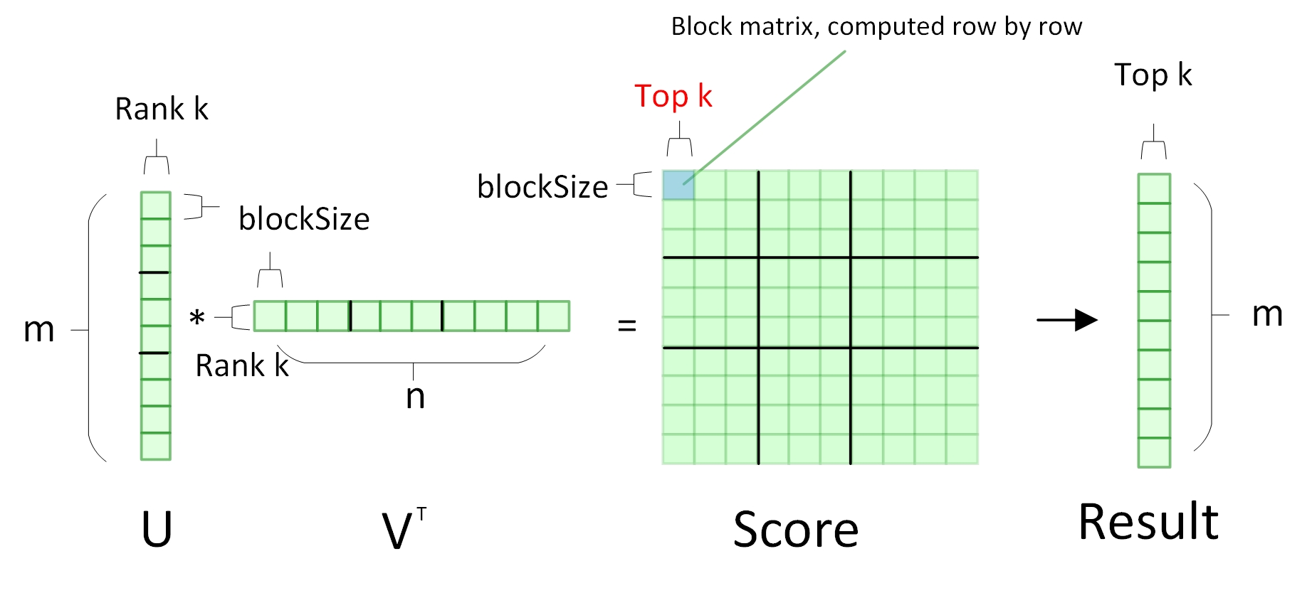
Solution (1) – Reduce GC overhead
Store only the Top K multiplication result instead of the whole matrix
Typical value:
Users m = (millions)
Items n = (millions)
Rank k = 20
BlockSize = 4096
TopK = 10
Suppose BlockSize = 4096 and topK = 20, saving 200x smaller objects in GC

Slide 9
Solution (1) – Reduce GC overhead
val ratings = srcBlocks.cartesian(dstBlocks).flatMap {
case (srcIter, dstIter) =>
pq = new BoundedPriorityQueue[(Int, Double)](n)
m = srcIter.size
n = math.min(dstIter.size, num)
output = new Array[(Int, (Int, Double))](m * n)
srcIter.foreach { case (srcId, srcFactor) =>
dstIter.foreach { case (dstId, dstFactor) =>
score = srcFactor * dstFactor
pq += dstId -> score }
while (pq.noEmpty) {output += (srcId, pq.next())} }
output.toSeq
}
ratings.topByKey(num)
val ratings = srcBlocks.cartesian(dstBlocks).flatMap {
case ((srcIds, srcFactors), (dstIds, dstFactors)) =>
rating =srcFactors.transpose.multiply(dstFactors)
m = srcIds.length
n = dstIds.length
output = new Array[(Int, (Int, Double))](m * n)
rating.foreachActive { output += (srcId, (dstId, r))}
output.toSeq
}
ratings.topByKey(num)
Reduce 99% memory
Reduce 99% memory
Reduce 99% shuffle data

Slide 10
Performance Benchmark (1)
Hardware/Software/Data
CPU (E5-2699 v3), 210GB memory, 10Gb network, Intel 320 SSD
1 master, 3 worker; 3 executor, 35 core for each executor
Netflix data: 480,189 users, 17,770 items
Results
More than 12X performance
improvement

Slide 11
Performance Benchmark (2)
Hardware/Software/Data
CPU (E5-2699 v3), 210GB memory, 10Gb network, Intel 320 SSD
1 master, 3 worker; 3 executor, 35 core for each executor
JD data: 3,290,837 users, 208,111 items
Results
More than 60X performance improvement
Original method is frequently OOM for
this size of data
This time is estimated
based on completed tasks,
OOM frequently.

Slide 12
Performance Benchmark from Customer
Spark Configuration (hardware configuration unknown, in a 3000 nodes YARN cluster)
num-executors = 200, driver-memory = 20g, executor-memory = 15g, executor-cores = 10
Results
Performance Gain
Performance improves about 100X
Users | Items | Records | New Prediction Time (min) | Original Prediction Time (min)
333380 | 331574 | 5196668 | 6.5 | 720
490617 | 547222 | 7297776 | 7.38 | Fail
981107 | 794695 | 14634874 | 5.85 | Fail
4584400 | 1835989 | 68402048 | 29.12 | Fail
6877868 | 2262130 | 102503089 | 52.05 | Fail
13755446 | 3164663 | 205107515 | 107.7 | Fail

Slide 13
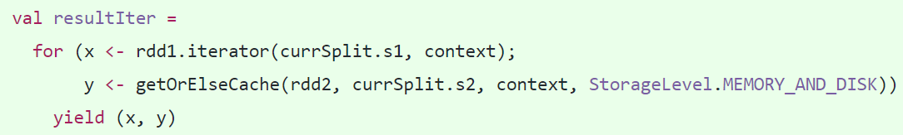
Solution (2) –Reduce partition re-fetching
Reduce the overhead of CartesianRDD (re-fetching the data blocks remotely)
Blockify the features to reduce the re-fetching times.(Done by upstream, and BlockSize is the parameter to adjust the features size in each block)
Cache the remote data block locally (SPARK-20638)
Large Block Data will reduce the record counts in each partition, but may cause more memory consumption.
Cache the remote partition locally for future usage. Most code change in Spark Core (BlockManager)

Slide 14
Performance Benchmark (3)
Hardware/Software/Data
CPU (E5-2699 v3), 210GB memory, 10Gb network, Intel 320 SSD
1 master, 3 worker; 3 executor, 35 core for each executor
JD data: 3,290,837 users, 208,111 items
Results
With partition cache,
we get another 10%
performance improvement

Slide 15
Solution (3) – Boost the performance again
val ratings = srcBlocks.cartesian(dstBlocks).flatMap {
case (srcIter, dstIter) =>
m = srcIter.size
n = math.min(dstIter.size, num)
output = new Array[(Int, (Int, Double))](m * n)
pq = new BoundedPriorityQueue[(Int, Double)](n)
srcIter.foreach { case (srcId, srcFactor) =>
dstIter.foreach { case (dstId, dstFactor) =>
score = srcFactor * dstFactor
pq += dstId -> score }
while (pq.noEmpty) {output += (srcId, pq.next())} }
output.toSeq
}
ratings.topByKey(num)

Slide 16
Solution (3) – Optimize by BLAS GEMM
val ratings = srcBlocks.cartesian(dstBlocks).flatMap {
case (srcIter, dstIter) =>
m = srcIter.size
n = math.min(dstIter.size, num)
output = new Array[(Int, (Int, Double))](m * n)
pq = new BoundedPriorityQueue[(Int, Double)](n)
srcIter.foreach { case (srcId, srcFactor) =>
dstIter.foreach { case (dstId, dstFactor) =>
score = srcFactor * dstFactor
pq += dstId -> score }
while (pq.noEmpty) {output += (srcId, pq.next())} }
output.toSeq
}
ratings.topByKey(num)

Slide 17
Solution (3) – Optimize by GEMM
val ratings = srcBlocks.cartesian(dstBlocks).flatMap {
case (srcIter, dstIter) =>
m = srcIter.size
n = math.min(dstIter.size, num)
output = new Array[(Int, (Int, Double))](m * n)
pq = new BoundedPriorityQueue[(Int, Double)](n)
srcIter.foreach { case (srcId, srcFactor) =>
dstIter.foreach { case (dstId, dstFactor) =>
score = srcFactor * dstFactor
pq += dstId -> score }
while (pq.noEmpty) {output += (srcId, pq.next())} }
output.toSeq
}
ratings.topByKey(num)
Use two matrix to replace output (object array) to reduce GC.
dstIdMatrix = Array[Int](m * num)
scoreMatrix = Array[Double](m * num)
Use BLAS GEMM to replace hand matrix multiplication
Use merge to replace topByKey which use priorityQueue
Time complexity from O(nlog(n)) -> O(n)

Slide 18
Performance Benchmark (4)
Hardware/Software/Data
CPU (E5-2699 v3), 210GB memory, 10Gb network, Intel 320 SSD
1 master, 3 worker; 3 executor, 35 core for each executor
Netflix data: 480,189 users, 17,770 items
Results
About 0.5X performance
improvement

Slide 19
Settings to boost the performance
Disable multi-threading for Native BLAS
Use Native BLAS or F2J BLAS
Use number of physical cores or virtual cores

Slide 20
Reference
SPARK-20446: https://issues.apache.org/jira/browse/SPARK-20446
SPARK-20443: https://issues.apache.org/jira/browse/SPARK-20443
SPARK-20638: https://issues.apache.org/jira/browse/SPARK-20638
SPARK-21305: https://issues.apache.org/jira/browse/SPARK-21305
SPARK-21398: https://issues.apache.org/jira/browse/SPARK-21398

